Slide 1

Cloud-Native Internship & Skill Matching Platform
CNAD Project Review-3
28-10-2026
 | Under the Guidance of Dr. Srilatha Patha Associate Professor, Department of Computer Science and Engineering, KLH CSE Bowrampet Campus
Team Members K. Dhishitha 2420030314 Divya Charan 2420030429 Aasritha. A 2420090127

Slide 2
Problem Definition
Students often find it difficult to discover internships that match their skills, interests, and career goals.
Existing internship platforms mainly depend on keyword-based searches, which may show many irrelevant opportunities.
Employers receive a large number of applications, making candidate screening time-consuming.
There is a lack of an efficient system that provides skill-based matching between students and internship requirements.
A centralized platform is needed to help students find relevant internships and help employers identify suitable candidates efficiently.

Slide 3
Requirements
User Registration & Login – Separate access for students and employers.
Profile Management – Students can manage their education, skills, and interests.
Internship Management – Employers can post and manage internship opportunities.
Search & Filtering – Students can search internships by role, skills, location, and type.
Skill-Based Matching – Calculate the percentage match between student skills and internship requirements.
Application Management – Students can apply for internships and track their application status.
Applicant Management – Employers can view, filter, and manage applicants.
Secure Authentication – Provide secure login and role-based access.
Responsive Interface – Support desktop, tablet, and mobile devices.
Cloud-Native Deployment – Use Docker, Kubernetes, Helm, and CI/CD for deployment and scalability.

Slide 4
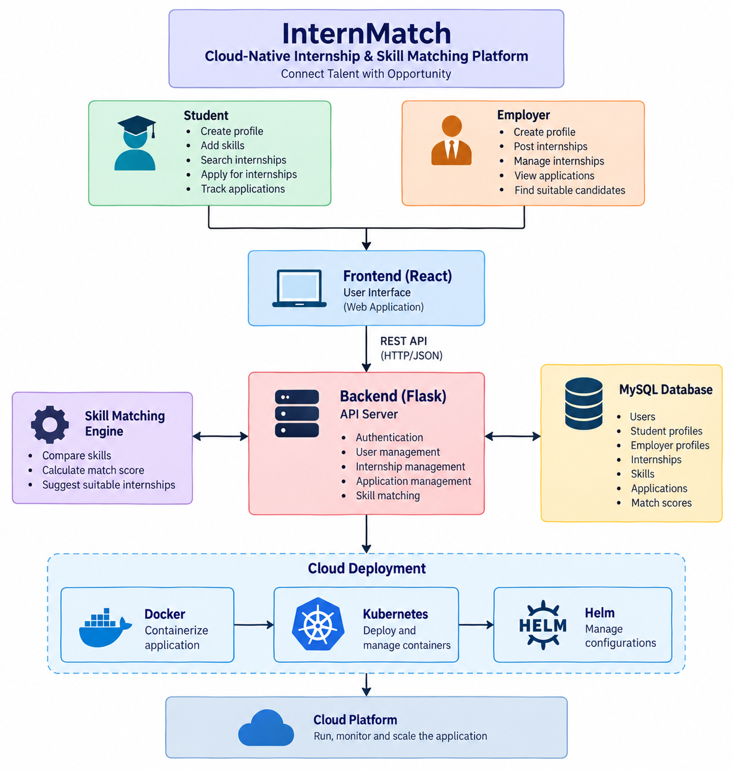
System Architecture & Design

Slide 5
Module Design
1. Authentication Module
Handles secure access to the platform through user registration, login, JWT authentication, and role-based access for students and employers.
2. Student Module
Allows students to create profiles, add skills and academic details, search for internships, apply for suitable opportunities, and track their applications.
3. Employer Module
Allows employers to create company profiles, post internship opportunities, define required skills, manage internships, and view student applications.
4. Internship Module
Manages internship information such as title, description, domain, location, duration, stipend, eligibility, and application deadline.
5. Skill Management Module
Maintains student skills and internship skill requirements, including proficiency, experience, skill type, and skill weight.

Slide 6
Module Design
6. Skill Matching Module
Compares student skills with internship requirements, calculates a match score, and identifies matched and missing skills to recommend suitable internships.
7. Application Module
Manages the complete internship application process, including submitting applications, cover letters, resumes, application status, and application tracking.
8. Database Module
Stores and manages all platform data including users, profiles, internships, skills, applications, and match scores using MySQL.
9. Cloud & Deployment Module
Containerizes the application using Docker and deploys it using Kubernetes and Helm, with CI/CD, security scanning, scaling, and monitoring for cloud-native operation.

Slide 7
Module Integration
Authentication → User Modules
Users log in and are given access according to their role.
Student → Skill Management
Student profiles are connected with their skills and experience.
Employer → Internship Management
Employers create internships and specify required skills.
Student Skills + Internship Skills → Matching Module
The matching engine compares both sets of skills and generates a match score.
Matching → Internship Recommendations
Suitable internships are displayed to students based on their match scores.
Student → Application Module
Students can apply for selected internships and track their application status.
Employer → Application Module
Employers can view and manage applications received for their internships.
All Modules → MySQL
User data, profiles, skills, internships, applications, and match scores are stored in the database.
Application → Cloud Deployment
The complete application is later containerized using Docker and deployed using Kubernetes + Helm.

Slide 8
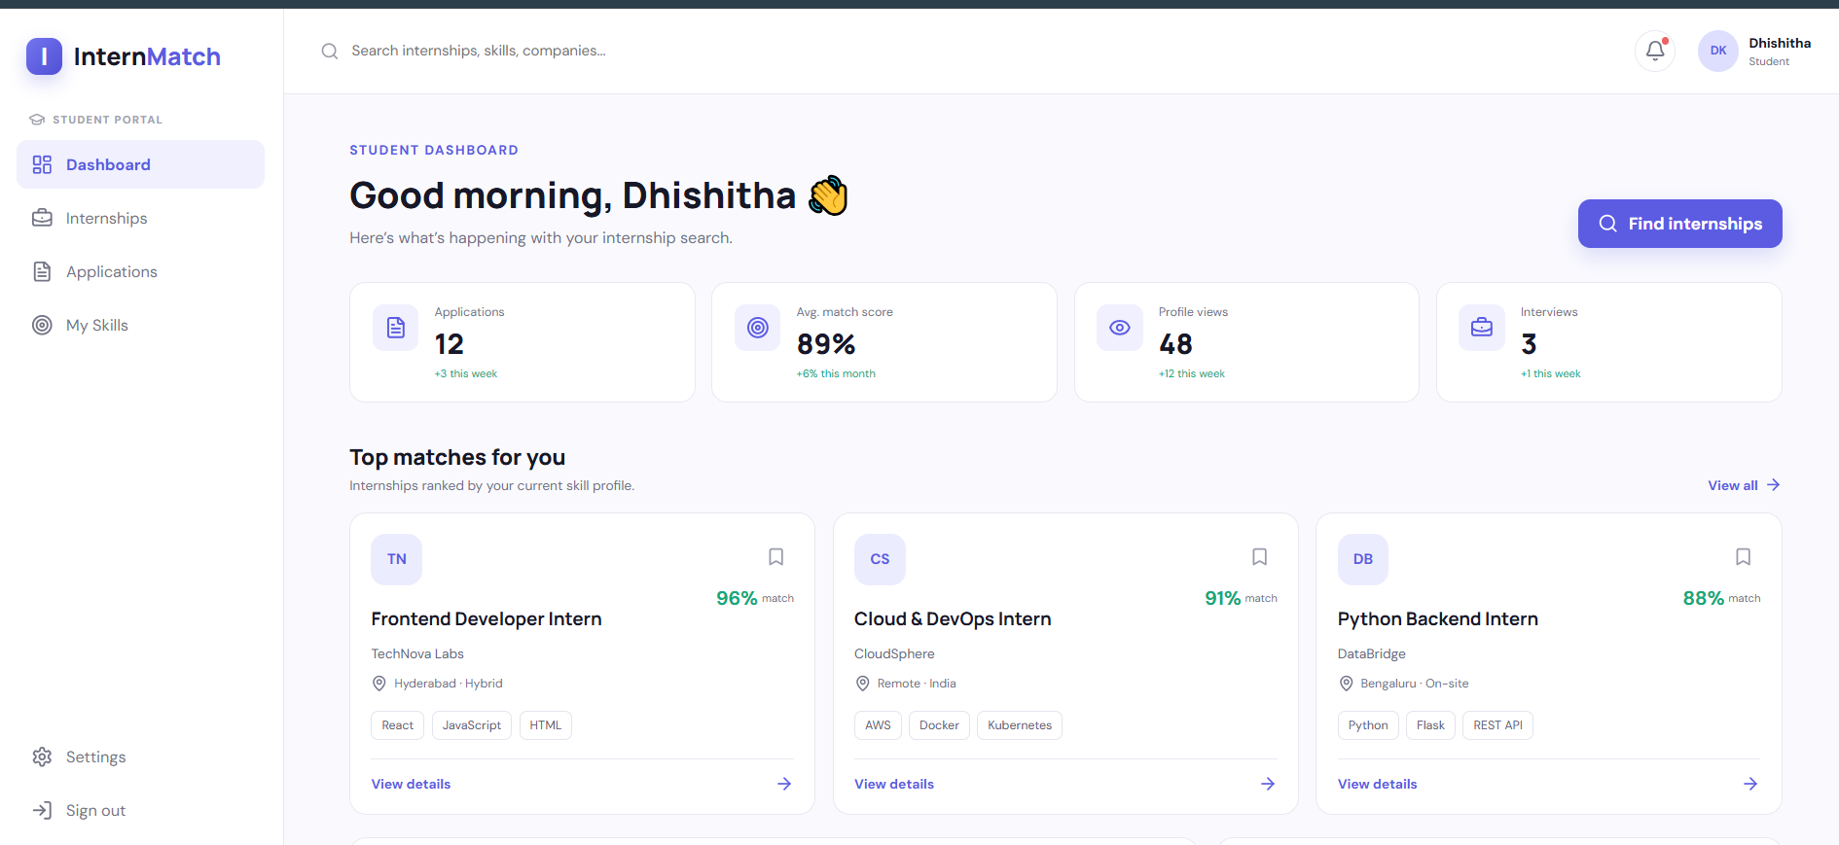
Project Implementation

Slide 9
Current Progress
Designed the system architecture and defined the major application modules.
Developed the student dashboard interface for displaying internship recommendations.
Designed modules for student profiles, employer management, internships, and applications.
Established the skill-matching approach to recommend relevant internship opportunities.
Worked on integrating the frontend, backend, and MySQL database.
Explored cloud-native deployment using Docker, Kubernetes, and Helm.

Slide 10
Future Enhancements
Future Enhancements
Improve skill-matching accuracy using advanced recommendation techniques.
Implement comprehensive testing for APIs, database operations, and application workflows.
Strengthen authentication, authorization, and data security.
Complete and optimize containerized deployment using Docker and Kubernetes.
Enhance application performance, scalability, and error handling.
Improve the user interface and add notifications for internship and application updates.

Slide 11
Results
Successfully developed the initial implementation of the Cloud-Native Internship & Skill Matching Platform, InternMatch.
Designed a user-friendly interface for students to explore internship opportunities and view skill-based recommendations.
Established the system architecture integrating the frontend, backend, and MySQL database.
Designed modules for user authentication, student profiles, internship management, and application tracking.
Developed the skill-matching approach to identify suitable internships based on student skills and internship requirements.
Worked on containerization and cloud-native deployment using Docker, Kubernetes, and Helm.
Identified further improvements in testing, integration, and deployment to enhance the platform's reliability and scalability.

